Slide 1
Computational Geometry
Convex Hull
Line Segment Intersection

Slide 2
Algorithms about points, lines, planes, polygons, triangles, rectangles and other geometric objects.
Applications in many fields
  robotics, graphics, CAD/CAM, geographic systems,
We have done some already
  Euclidian traveling salesman
  Nearest neighbors

Slide 3
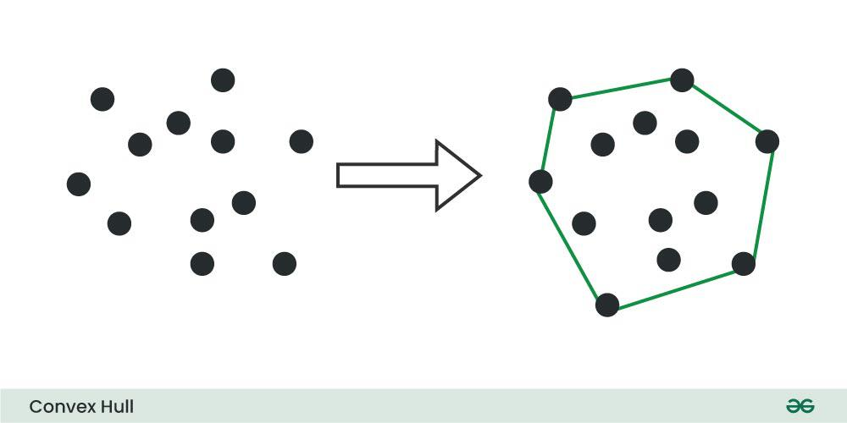
Convex Hull – 2D
convex hull is the smallest convex polygon that contains a given set of points.
It is a useful concept in computational geometry and has applications in various fields such as computer graphics, image processing, and collision detection.
A convex polygon is a polygon in which all interior angles are less than 180 degrees. A convex hull can be constructed for any set of points, regardless of their arrangement.

Slide 4



Convex polygon: all interior angles are less than 180∘
Equivalently: line drawn through polygon will intersect exactly twice
Problem: given a set of 𝑛 points, find the smallest convex polygon such that every point is either on the boundary or the interior of the polygon

Slide 5
The Convex Hull Problem
Convex polygon: all interior angles are less than 180∘
Equivalently: line drawn through polygon will intersect exactly twice
Not convex!
> 180∘
> 180∘
Problem: given a set of 𝑛 points, find the smallest convex polygon such that every point is either on the boundary or the interior of the polygon

Slide 6
The Convex Hull Problem
Rubber band
Rubber band analogy: imagine the points are nails sticking out of a board and wrapping a rubber band to encompass the nails; convex hull is resulting shape
12

Slide 7
The Convex Hull Problem
Otherwise, can add a “shortcut” and reduce the area
Observation: every point on the convex hull is one of the input points
13

Slide 8

Convex Hull – Problem Formulation
Given n points on the plane find the smallest enclosing curve.

Slide 9
Convex Hull – 2D
The convex hull is a polygon whose vertices are some of the points.

Slide 10
Input:
Set of points p₁, p₂, ... , p_{n} in 2 space. (Each point is an ordered pair p = (x,y) of reals.)
Output:
A sequence of points p_{i1}, p_{i2}, ... , p_{ik} such that traversing these points in order gives the convex hull.

Slide 11
p₂
p₁
^{p}11
p₃
p₈ p₉
p
4
^{p}12
p
7
p₆
p₅
^{p}10
Input: p₁, p₂, p₃, p₄, p₅, p₆, p₇, p₈, p₈, p₉, p₁₀, p₁₁, p₁₂ Output: p₆, p₁, p₂, p₁₁, p₁₂, p₁₀

Slide 12




A Brute Force Approach
Observation: if there are points on both sides of the line, then the pair cannot be an edge in the convex hull
Run-time: 𝑂 𝑛¹
Brute force approach: for every pair of points, check if all other points are on the same side of the line
15

Slide 13
Graham Scan
The Graham scan algorithm is a simple and efficient algorithm for computing the convex hull of a set of points.
It works by iteratively adding points to the convex hull until all points have been added.
The algorithm starts by finding the point with the smallest y-coordinate.
If there are multiple points with the same Y coordinate, the one with the smaller X coordinate is considered. This step takes O(N)time.
This point is always on the convex hull.
The algorithm then sorts the remaining points by their polar angle with respect to the starting point.
The algorithm then iteratively adds points to the convex hull.
At each step, the algorithm checks whether the last two points added to the convex hull form a right turn.
If they do, then the last point is removed from the convex hull. Otherwise, the next point in the sorted list is added to the convex hull.
The algorithm terminates when all points have been added to the convex hull.

Slide 14
Graham Scan
If you need to include the collinear points while doing a Graham scan, you need another step after sorting. You need to get the points that have the biggest polar distance from P₀ and are collinear.
If there is a positive slope order points from left to right.
If there is a negative slope do the reverse.
If it is vertical order from top to bottom.
the Graham's scan algorithm published in 1972 by Graham, and also the Monotone chain algorithm published in 1979 by Andrew.
Both are O(N log⁡N)and are asymptotically optimal

Slide 15
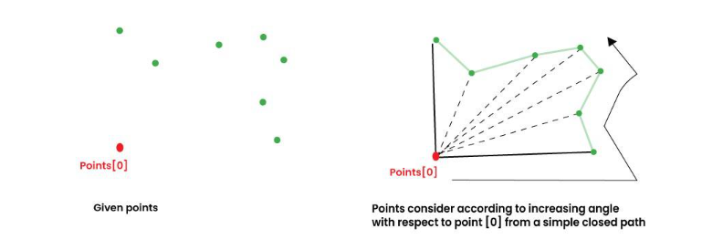
Let points[0..n-1] be the input array.
Then the algorithm can be divided into two phases:
Phase 1 (Sort points):
find the bottom-most point.
The idea is to pre-process points be sorting them with respect to the bottom-most point.
Once the points are sorted, they form a simple closed path
sorting criteria?
computation of actual angles would be inefficient since trigonometric functions are not simple to evaluate.
The idea is to use the orientation to compare angles without actually computing them

Slide 16
Phase 2 (Accept or Reject Points):
Once we have the closed path, the next step is to traverse the path and remove concave points on this path.
How to decide which point to remove and which to keep?
Again, orientation helps here.
The first two points in sorted array are always part of Convex Hull.
For remaining points, we keep track of recent three points, and find the angle formed by them.
Let the three points be prev(p), curr(c) and next(n).
If orientation of these points (considering them in same order) is not counterclockwise, we discard c, otherwise we keep it. (Use vector product of segments pc and cn)
Following diagram shows step by step process of this phase.

Slide 17
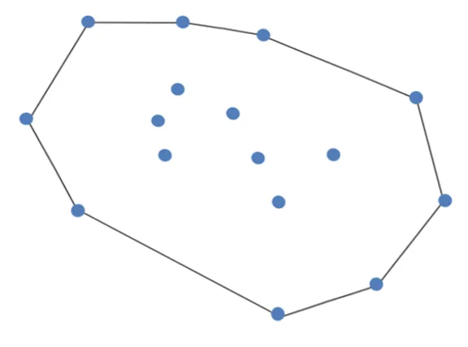
Graham’s scan is a method for finding the convex hull that encompasses all points on the plane. Below you’ll see an example of a convex hull.

Slide 18
Graham Scan Technique
Graham’s scan starts by finding the point with the lowest y coordinate.
If there are multiple points on the y-coordinate, the point with the smallest x-value is chosen.
The points are sorted by polar angles in counterclockwise rotation.
Graham’s scan utilizes the stack.
Points are pushed onto the stack.
If the point is not part of the convex hull, the point is popped from the stack.

Slide 19
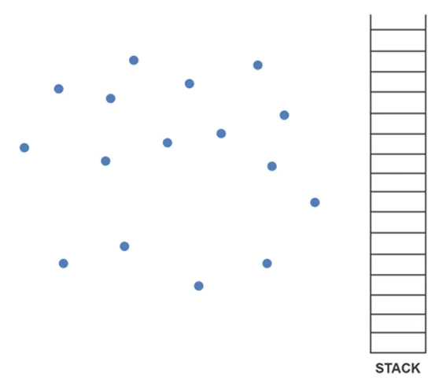
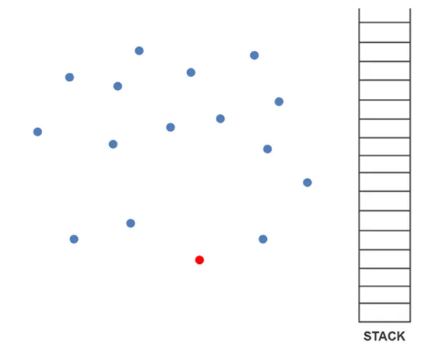
We have a set of points.
It is clear which point has the lowest
y-coordinate value.

Slide 20
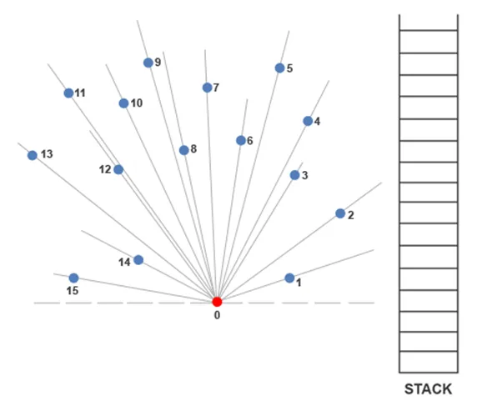
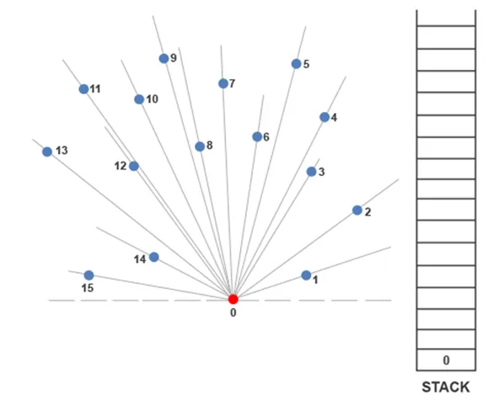
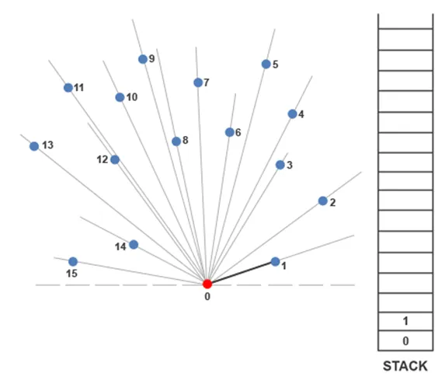
Now we can follow Graham’s scan to find out which points create the convex hull. Point 0 is pushed onto the stack.
From there, points are ordered in increasing angle.
Point 1 is pushed onto the stack immediately after.

Slide 21
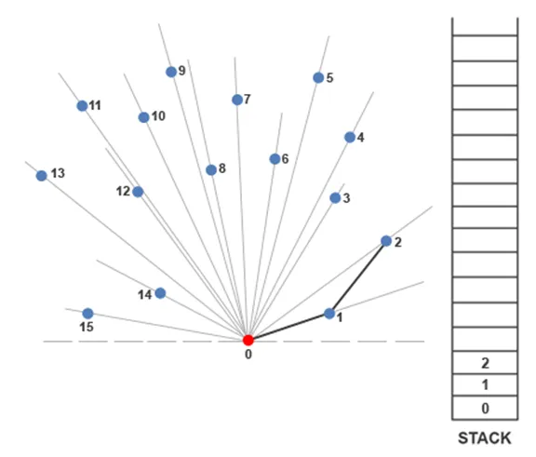
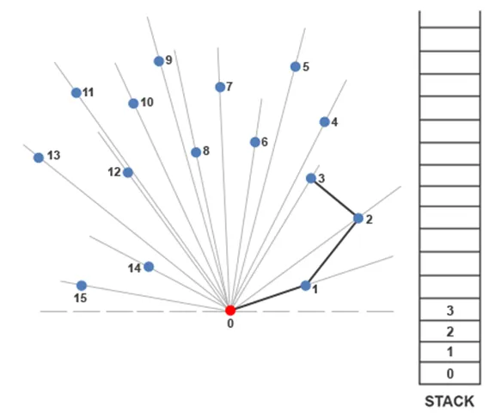
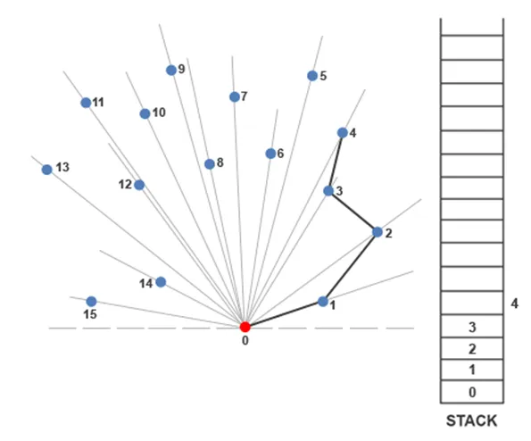
The next point to be added to the stack is 2. A line is made from point 1 to point 2.
Whenever a left turn is made, the point is presumed to be part of the convex hull.
We can clearly see a left turn being made to reach 2 from point 1.
To get to point 3, another left turn is made.
Currently, point 3 is part of the convex hull.
A line segment is drawn from point 2 to 3 and 3 is pushed onto the stack.
There is a right turn going to point 4.
We’ll draw the line to point 4 but will not push it onto the stack.

Slide 22
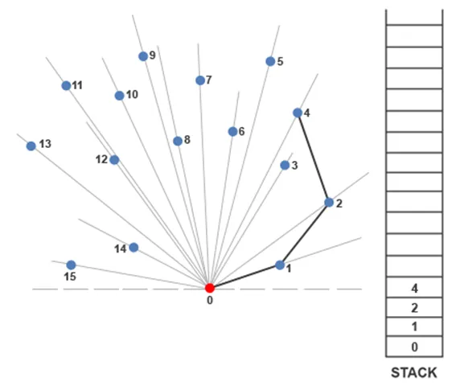
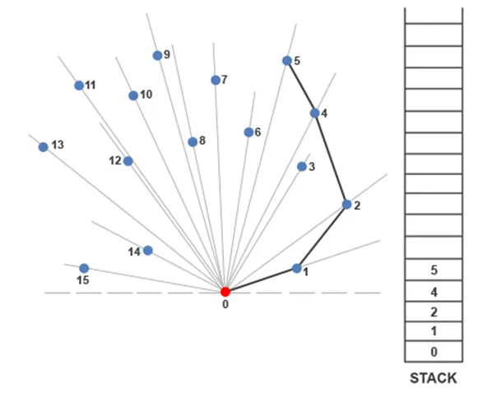
Whenever a right turn is made, Graham’s scan algorithm pops the previous value from the stack and compares the new value with the top of the stack again.
In this case, we’ll pop 3 from the top of the stack and we’ll see if going from point 2 to point 4 creates a left bend.
In this case it does, so we’ll draw a line segment from 2 to 4 and push 4 onto the stack.
Since going from 4 to 5 creates a left turn,
we’ll push 5 onto the stack.
Point 5 is currently part of the convex hull.

Slide 23
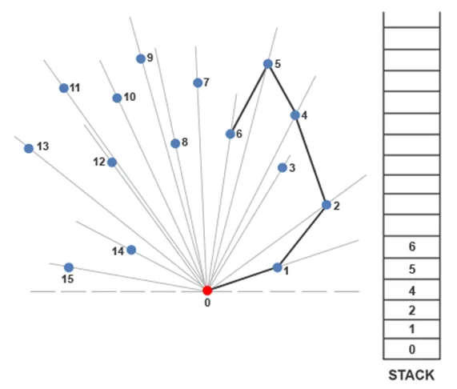
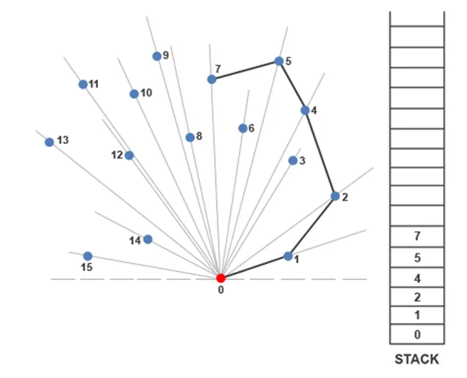
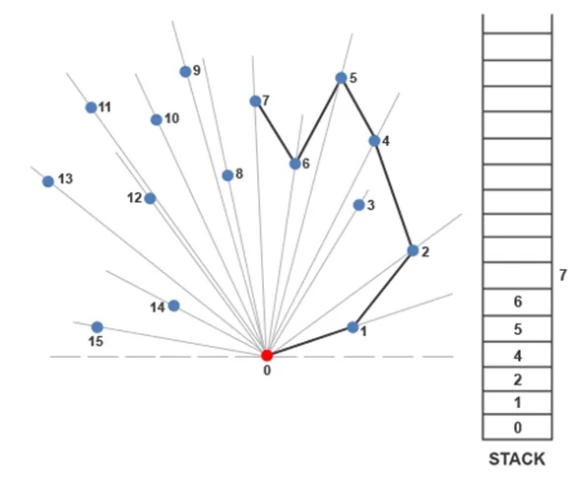
Moving from point 5 to 6 creates a left-hand turn, so we’ll push 6 onto the stack.
Point 6 is currently part of the convex hull.
Point 6 is popped from the stack and the turn is examined from point 5 to point 7.
Since we make a left-hand turn from point 5 to point 7, we push point 7 onto the stack.
To get to point 7, we must make a right-hand turn at 6.

Slide 24
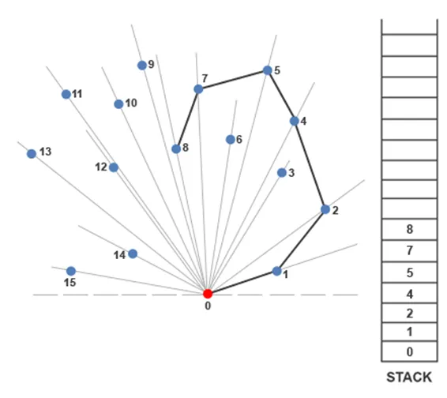
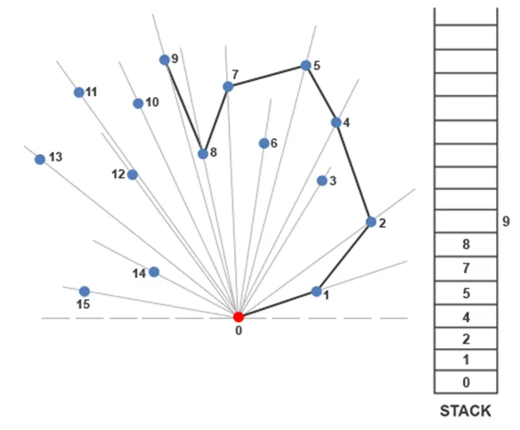
We attempt to push point 8 onto the stack.
To get to point 8, we make a left at point 7, therefore point 8 is added to the stack.
Point 8 is currently part of the convex hull.
Going to point 9 requires a right-hand turn at point 8.

Slide 25
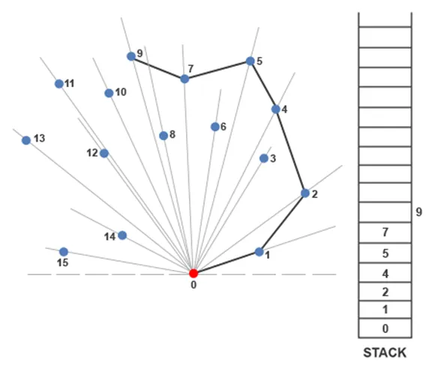
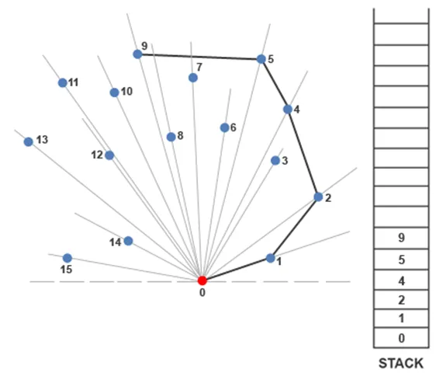
Since there’s a right-hand turn, point 8 is popped from the stack and point 9 is compared with point 7.
To get to point 9 from point 7 requires another right-turn, so we pop point 7 from the stack too and compare point 9 to point 5.
We make a left-hand turn at point 5 to get to point 9, so 9 is pushed onto the stack.

Slide 26
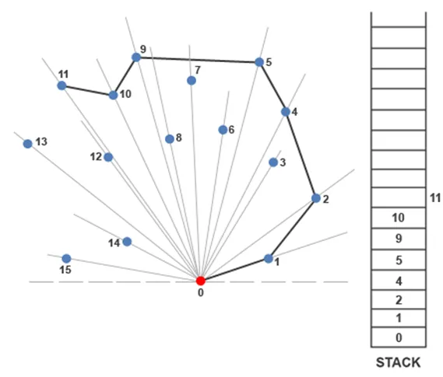
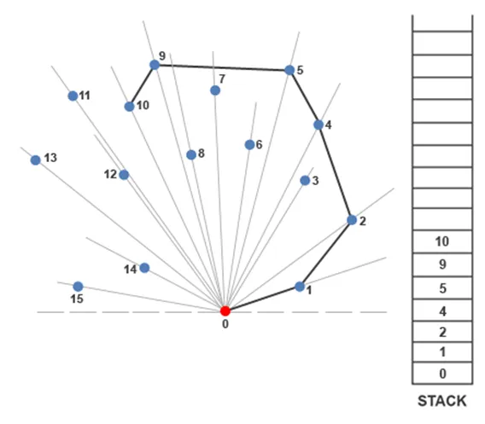

Next, we make a left turn to get to point 10. Point 10 is currently part of the convex hull.
A right turn is required to get to point 11
from point 10.
Since a right turn is taken at point 10, point 10 is popped from the stack and the path to point 10 from point 9 is examined.
Since a left turn is made at point 9 to get to point 11, point 11 is pushed onto the stack.

Slide 27
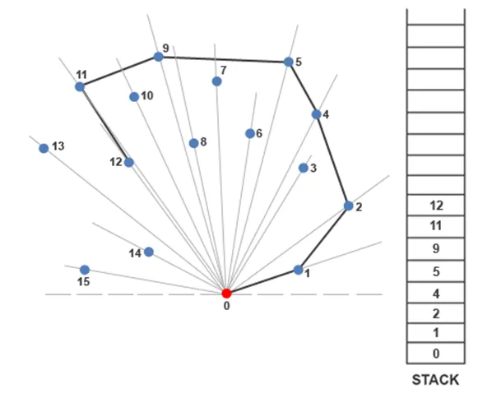
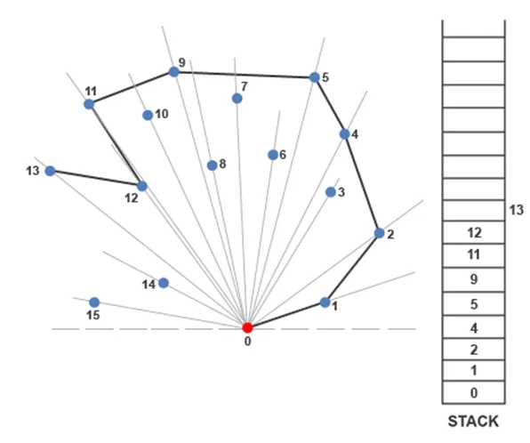
Since a right turn is taken at point 10, point 10 is popped from the stack and the path to point 10 from point 9 is examined.
Since a left turn is made at point 9 to get to point 11, point 11 is pushed onto the stack.
A left turn is made at point 11 to get to point 12. Point 12 is therefore pushed onto the stack and is currently considered part of the convex hull.
A right turn is required to go to point 13 from point 12.

Slide 28
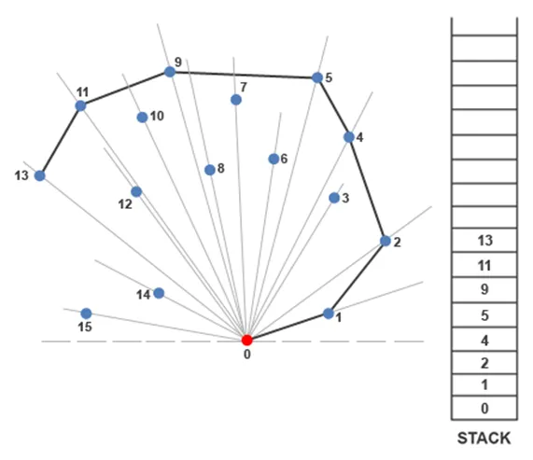
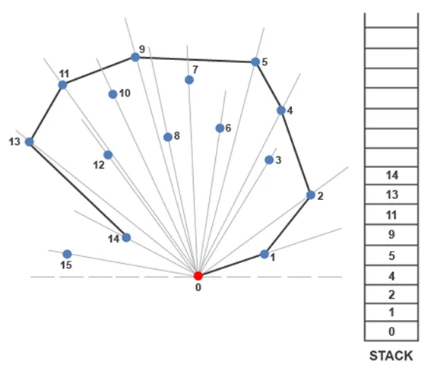
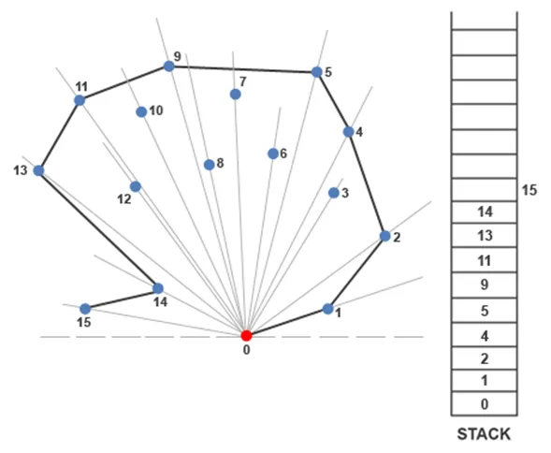
Point 12 is popped from the stack and the path to point 13 from point 11 is examined. Since a left turn is made at point 11, point 13 is pushed onto the stack.
A left turn is made at point 13 to get to point 14, so point 14 is pushed onto the stack.
A right turn is required to go from point 14 to point 15.

Slide 29
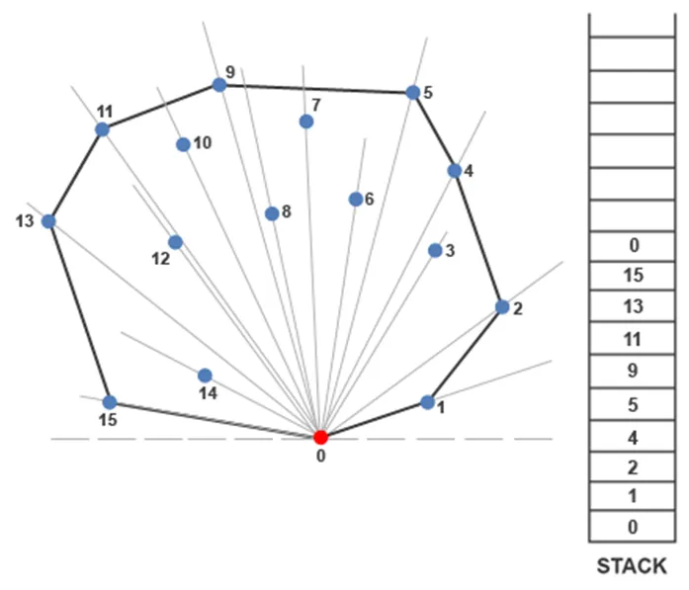
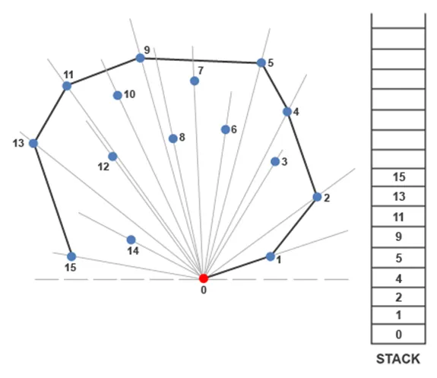
Since a right turn was made at point 14, point 14 is popped from the stack.
The path to point 15 from point 13 is examined next.
A left turn is made at point 13 to get to point 15, so point 15 is pushed onto the stack.
Going from point 15 to the starting point 0
requires a left turn.
Since the initial point was the point that we needed to reach to complete the convex hull, the algorithm ends.

Slide 30



Graham’s Algorithm
Polar Angle
Scan the points in order of angle
H
F
𝜃
J
G
D
C
I
E
K
B
𝑢
A
Idea: In order of angle, add points to the convex hull as long as it preserves convexity

Slide 31
Graham’s Algorithm
Let 𝑝₅ be the point with the smallest 𝑦-coordinate (and smallest 𝑥- coordinate if multiple points have the same minimum-𝑦 coordinate)
Add 𝑝₅ to the convex hull 𝐶 (represented as an ordered list)
Sort all of the points based on their angle relative to 𝑝₅
For each of the points 𝑝₉ in sorted order:
  Try adding 𝑝₉ to the convex hull 𝐶
  If adding 𝑝₉ makes 𝐶 non-convex, then remove the last component of
𝐶 and repeat this check
How to implement this?
Imagine driving from 𝐴 → 𝐵
𝐵 → 𝐶 is convex if need to take a “left turn” to reach 𝐶
𝐵 → 𝐶 is non-convex if need to take a “non-left turn” Decide “left turn” vs. “right turn” by computing the sign of the (vector) cross product between 𝑣⃗_{𝐴𝐵} and 𝑣⃗_{𝐵𝐶}
36
𝑣⃗_{𝐵𝐶}
B
𝑣⃗_{𝐴𝐵}
C
Convex
Non-convex
A

Slide 32
Running Time of Graham’s Algorithm
Let 𝑝₅ be the point with the smallest 𝑦-coordinate (and smallest 𝑥- coordinate if multiple points have the same minimum-𝑦 coordinate)
Add 𝑝₅ to the convex hull 𝐶 (represented as a stack)
Sort all of the points based on their angle relative to 𝑝₅
For each of the points 𝑝₉ in sorted order:
  Try adding 𝑝₉ to the convex hull 𝐶
  If adding 𝑝₉ makes 𝐶 non-convex, then remove the last component of
𝐶 and repeat this check
𝑂(𝑛)
𝑂(1)
𝑂(𝑛 log 𝑛)
𝑂(1)
Running time: 𝑂(𝑛 log 𝑛)

Slide 33
For each pair of points p, q, form the line that passes through p and q and determine if all the other points are on one side of the line.
  If so the line from p to q is on the convex hull
  Otherwise not
Time Complexity is O(n³)
  Constant time to test if point is on one side of the line
0 = (q₂ − p₂ )x + (p₁ − q₁)y + p₂q₁ − p₁q₂

Slide 34

For each pair of points p, q determine if the line from p to q is on the convex hull.
No
Yes

Slide 35
Convex Hull – Jarvis Algorithm
The idea of Jarvis’s Algorithm is simple, we start from the leftmost point (or point with minimum x coordinate value) and we keep wrapping points in counterclockwise direction.
The big question is, given a point p as current point, how to find the next point in output?
The idea is to use orientation() here.
Next point is selected as the point that beats all other points at counterclockwise orientation, i.e., next point is q if for any other point r, we have “orientation(p, q, r) = counterclockwise”.

Slide 36

Algorithm:
Step 1) Initialize p as leftmost point.
Step 2) Do following while we don’t come back to the first (or leftmost) point.
2.1) The next point q is the point, such that the triplet (p, q, r) is counter clockwise for any other point r.
To find this, we simply initialize q as next point, then we traverse through all points.
For any point i, if i is more counter clockwise, i.e., orientation(p, i, q) is counter clockwise, then we update q as i.
Our final value of q is going to be the most counter clockwise point.
2.2) next[p] = q (Store q as next of p in the output convex hull).
2.3) p = q (Set p as q for next iteration).

Slide 37
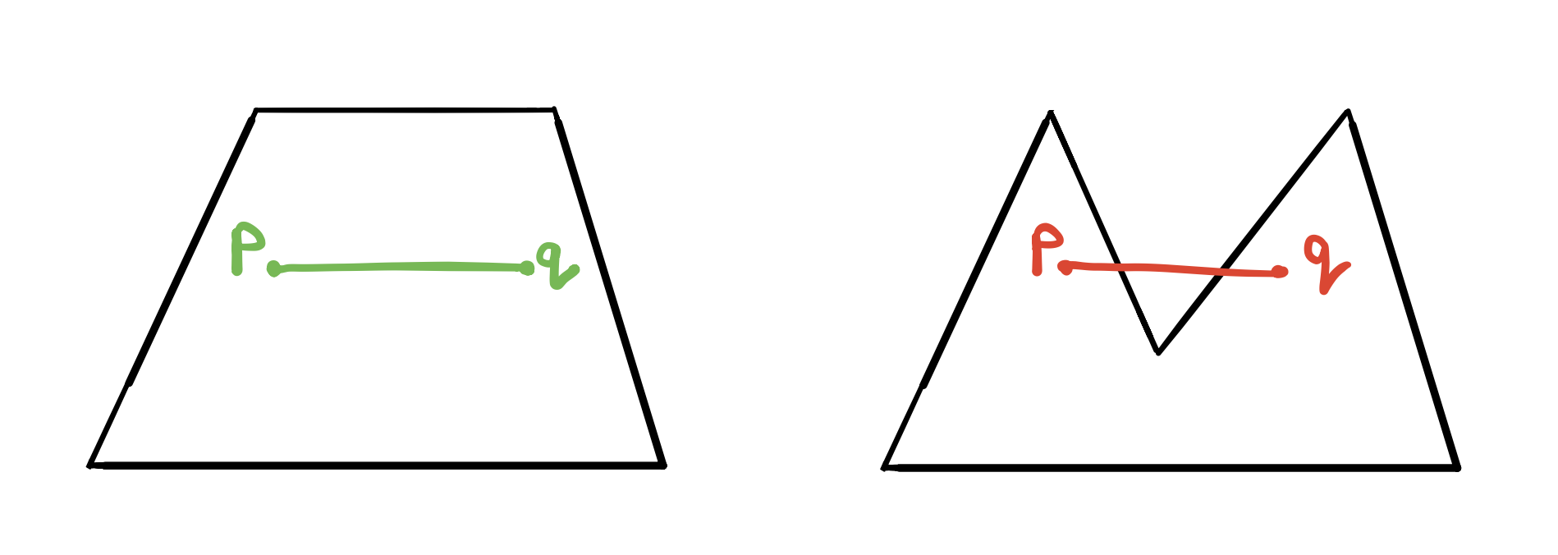
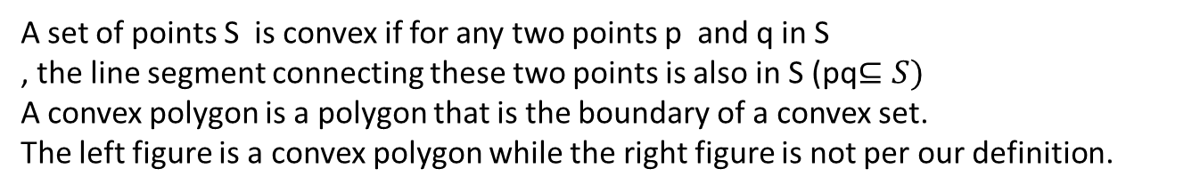
Jarvis’s March – Gift Wrapping
Convexity
A set of points S is convex if for any two points p and q in S
, the line segment connecting these two points is also in S (pq$⊆S)$
A convex polygon is a polygon that is the boundary of a convex set.
The left figure is a convex polygon while the right figure is not per our definition.

Slide 38
Jarvis’ Algorithm (Gift Wrapping Method)
𝑢
Idea: Start with extremal point and “wrap” points in counter-clockwise fashion

Slide 39
Jarvis’ Algorithm (Gift Wrapping Method)
𝑢
Idea: Start with extremal point and “wrap” points in counter-clockwise fashion

Slide 40
Jarvis’ Algorithm (Gift Wrapping Method)
𝑢
Idea: Start with extremal point and “wrap” points in counter-clockwise fashion

Slide 41
Jarvis’ Algorithm (Gift Wrapping Method)
𝑢
Idea: Start with extremal point and “wrap” points in counter-clockwise fashion

Slide 42
Jarvis’ Algorithm (Gift Wrapping Method)
𝑢
Idea: Start with extremal point and “wrap” points in counter-clockwise fashion

Slide 43
Jarvis’ Algorithm (Gift Wrapping Method)
𝑢
Idea: Start with extremal point and “wrap” points in counter-clockwise fashion

Slide 44
Jarvis’ Algorithm (Gift Wrapping Method)
𝑢
Idea: Start with extremal point and “wrap” points in counter-clockwise fashion

Slide 45
Jarvis’ Algorithm (Gift Wrapping Method)
𝑢
Idea: Start with extremal point and “wrap” points in counter-clockwise fashion

Slide 46
Jarvis’ Algorithm (Gift Wrapping Method)
𝑢
Idea: Start with extremal point and “wrap” points in counter-clockwise fashion

Slide 47
Jarvis’ Algorithm (Gift Wrapping Method)
𝑢
Idea: Start with extremal point and “wrap” points in counter-clockwise fashion

Slide 48
Jarvis’ Algorithm (Gift Wrapping Method)
𝑢
Idea: Start with extremal point and “wrap” points in counter-clockwise fashion

Slide 49
Jarvis’ Algorithm (Gift Wrapping Method)
𝑢
Idea: Start with extremal point and “wrap” points in counter-clockwise fashion

Slide 50
Jarvis’ Algorithm (Gift Wrapping Method)
𝑢
Idea: Start with extremal point and “wrap” points in counter-clockwise fashion

Slide 51
Jarvis’ Algorithm (Gift Wrapping Method)
𝑢
Idea: Start with extremal point and “wrap” points in counter-clockwise fashion

Slide 52
Jarvis’ Algorithm (Gift Wrapping Method)
𝑢
Idea: Start with extremal point and “wrap” points in counter-clockwise fashion

Slide 53
Jarvis’ Algorithm (Gift Wrapping Method)
𝑢
Idea: Start with extremal point and “wrap” points in counter-clockwise fashion

Slide 54
Jarvis’ Algorithm (Gift Wrapping Method)
𝑢
Idea: Start with extremal point and “wrap” points in counter-clockwise fashion

Slide 55
Jarvis’ Algorithm (Gift Wrapping Method)
𝑢
Idea: Start with extremal point and “wrap” points in counter-clockwise fashion

Slide 56
Jarvis’ Algorithm (Gift Wrapping Method)
𝑢
Idea: Start with extremal point and “wrap” points in counter-clockwise fashion

Slide 57
Jarvis’ Algorithm (Gift Wrapping Method)
𝑢
Idea: Start with extremal point and “wrap” points in counter-clockwise fashion

Slide 58
Jarvis’ Algorithm (Gift Wrapping Method)
𝑢
Idea: Start with extremal point and “wrap” points in counter-clockwise fashion

Slide 59
Jarvis’ Algorithm (Gift Wrapping Method)
𝑢
Idea: Start with extremal point and “wrap” points in counter-clockwise fashion

Slide 60
Jarvis’ Algorithm (Gift Wrapping Method)
𝑢
Can find the “next” point using a linear scan (i.e., point with largest angle)
Number of iterations: number of points on convex hull
Run time: 𝑂(𝑛ℎ) where ℎ is the number of points on the convex hull

Slide 61
Jarvis’ Algorithm (Gift Wrapping Method)
Output-dependent running time (similar to Ford-Fulkerson)
Can be better than Gra^{𝑢}ham’s Algorithm when ℎ ≪ log 𝑛
Can find• th_{W}e_{o}“_{r}n_{st}ex_{c}t_{a}”_{se}p:o_{ℎ}int₌u_{𝑛}si,n_{s}g_{o}a_{𝑂}lin_{𝑛}e^{M}ar scan
Number of iterations: number of points on convex hull
Run time: 𝑂(𝑛ℎ) where ℎ is the number of points on the convex hull

Slide 62
Example
Right Turn

Slide 63
Right Turn

Slide 64
Left Turn – back up

Slide 65
Left Turn – back up

Slide 67
Left Turn – back up

Slide 69
Right Turn

Slide 70
Left Turn – back up

Slide 72
Left Turn – back up

Slide 74
Left Turn – back up

Slide 76
Left Turn – back up

Slide 78
Upper convex hull is complete
Continue the process in reverse order to get the lower convex hull

Slide 79
Right Turn

Slide 80
Left Turn – back up

Slide 82
Right Turn

Slide 83
Left Turn – back up

Slide 84
Left Turn – back up

Slide 86
Right Turn

Slide 87
Left Turn – back up

Slide 89
Right Turn

Slide 90
Left Turn – back up

Slide 91
Left Turn – back up

Slide 92
Done!

Slide 93
Not a left turn
– Middle point is included in the convex hull

Slide 94
Sort
  First increasing in x
  Second decreasing in y

Slide 95

Slope increases from one segment to next
(p₁,p₂)
(r₁,r₂)
(q₁,q₂)
q₂ − p_{2 <} r₂ − q₂ q₁ − p₁ r₁ − q₁
left turn
(q₂ − p₂ )(r₁ − q₁) < (r₂ − q₂ )(q₁ − p₁)
to avoid dividing by zero

Slide 96
Sorting – O(n log n)
During the scan each point is “visited” at most twice
  Initial visit
  back up visit (happens at most once)
Scan - O(n)
Total time O(n log n)
This is best possible because sorting is reducible to finding convex hull.

Slide 97
O(n log n)
  Graham (1972)
O(n log h) algorithm where h is size of hull
  Kirkpatrick and Seidel (1986)
  Output sensitive algorithm
d-dimensional Convex Hull
  Ω(n^{d/2}) in the worst case because the output can be this large.

Slide 98
Given two convex hulls compute the combined convex hull in linear time.

Slide 99
Input
output

Slide 100
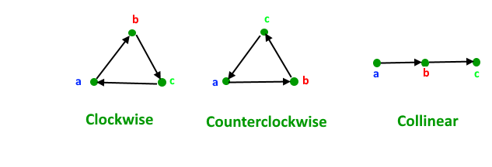
Orientation
Given two line segments (p1, q1) and (p2, q2), find if the given line segments intersect with each other.
Orientation of an ordered triplet of points in the plane can be
–counterclockwise
–clockwise
–collinear
The following diagram shows different possible orientations of (a, b, c)

Slide 101
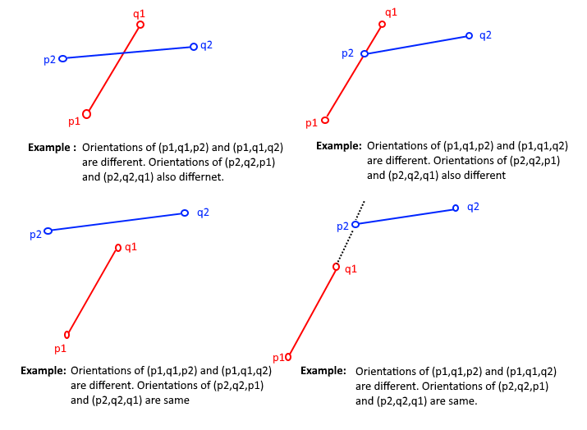
Two segments (p1,q1) and (p2,q2) intersect if and only if one of the following two conditions is verified
1. General Case:
– (p1, q1, p2) and (p1, q1, q2) have different orientations and
– (p2, q2, p1) and (p2, q2, q1) have different orientations.

Slide 102
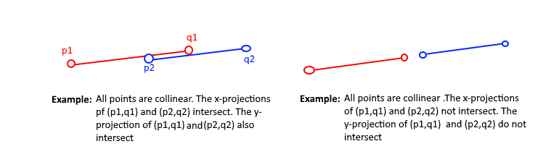
2. Special Case
– (p1, q1, p2), (p1, q1, q2), (p2, q2, p1), and (p2, q2, q1) are all collinear and
– the x-projections of (p1, q1) and (p2, q2) intersect
– the y-projections of (p1, q1) and (p2, q2) intersect

Slide 103
Line Segment Intersection Problem
Given n line segments (p1, q1), (p2, q2), … (pn, qn), find if the given line segments intersect with each other or not.
Example:
Input: {{1, 5}, {4, 5}}, {{2, 5}, {10, 1}},{{3, 2}, {10, 3}},{{6, 4}, {9, 4}},{{7, 1}, {8, 1}}
Output: 2
Explanation: Lines {{1, 5}, {4, 5}}, {{2, 5}, {10, 1}} are intersecting, as well as {{2, 5}, {10, 1}},{{3, 2}, {10, 3}}.
Naive Algorithm A naive solution to solve this problem is to check every pair of lines and check if the pair intersects or not.
We can check two line segments in O(1) time.
Therefore, this approach takes O(n²).

Slide 104
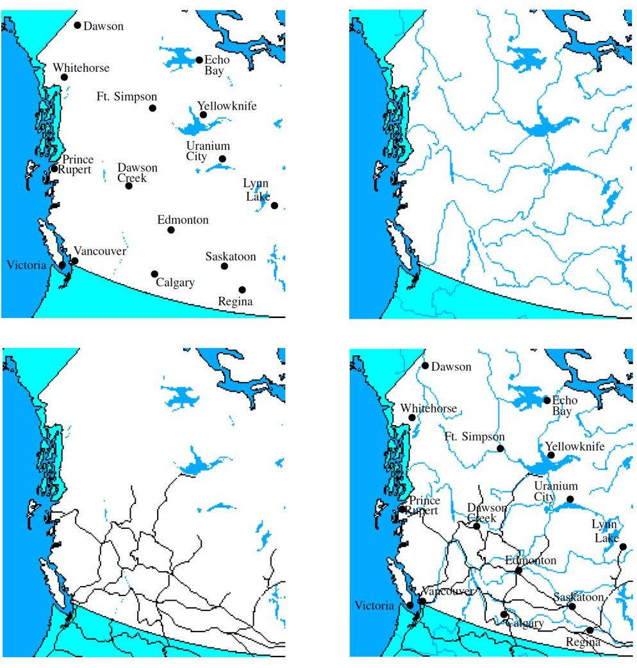
Geometric Intersections
Important problem in Computational Geometry
Solid modeling: Build shapes by applying set operations (intersection, union).
Robotics: Collision detection and avoidance
Geographic information systems: Overlay two subdivisions (e.g., road network and river network)

Slide 105
Line Segment Intersection
Input: A set S={s₁, …, s_{n}} of (closed) line segments in R²
Output: All intersection points between segments in S

Slide 106
Line Segment Intersection
n line segments can intersect as few as 0 and as many as
n
=O(n²) times
2
Simple algorithm: Try out all pairs of line segments
→ Takes O(n²) time
→ Is optimal in worst case
Challenge: Develop an output-sensitive algorithm
  Runtime depends on size k of the output
  Here: 0 ≤ k ≤ n²
– Best possible runtime: O(n log n + k) (why?)
→ O(n²) in worst case, but better in general

Slide 107

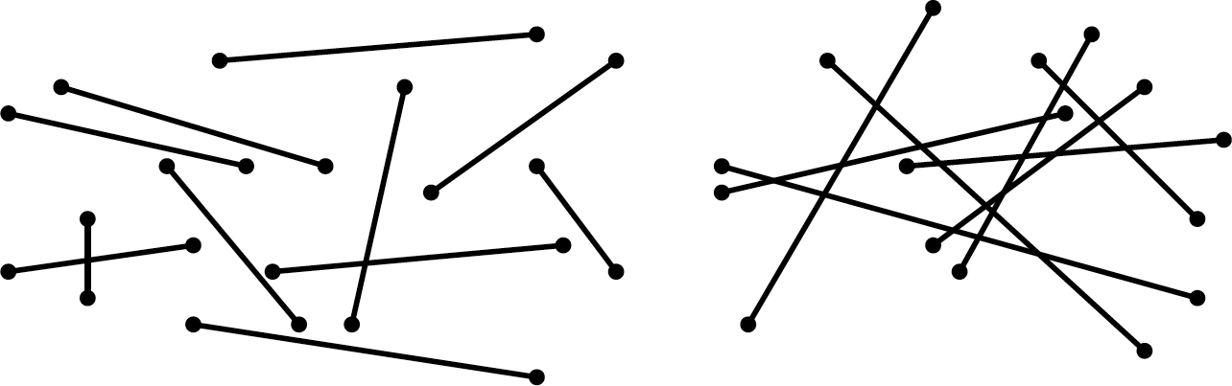
Output size for intersections
k = # of intersections
k = 2
k = 18

Slide 108
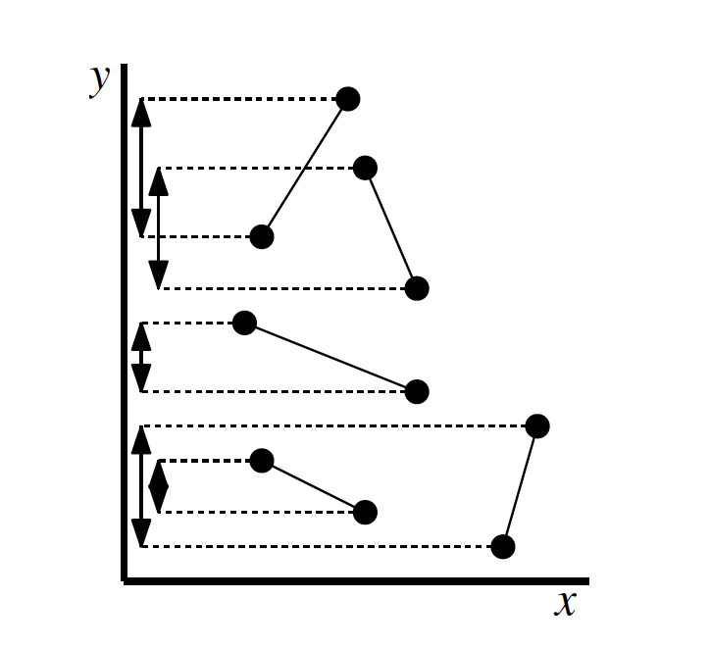
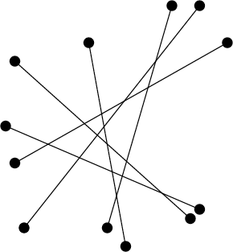
Output size for intersections
Range of k can go from 0 to order of n², i.e., n(n-1)/2, which is O(n²).
k = 0
k = 6(5)/2 = 15

Slide 109
With n line segments there may be O(n²) intersections.
Goal: Good output sensitive algorithm
– O(n log n + s) would be ideal where s is the number of intersections.
The Shamos–Hoey algorithm applies sweep line technique to solve the line segment intersection detection problem, of determining whether or not a set of line segments has an intersection;
the Bentley–Ottmann algorithm works by the same principle to list all intersections in logarithmic time per intersection.

Slide 110
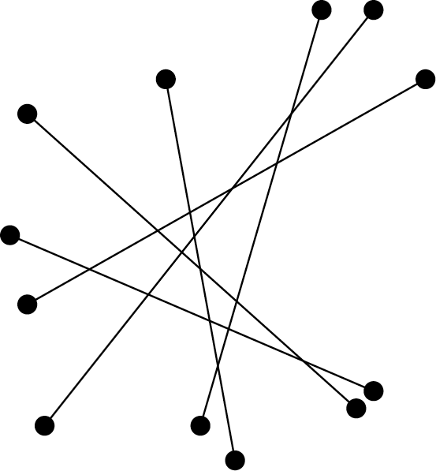
General position
Assume that “nasty” special cases don’t happen:
No line segment is vertical
Two segments intersect in at most one point
No three segments intersect
in a common point

Slide 111

report the point and all the lines that meet there.
Report the segment and all the lines that meet on it.

Slide 112
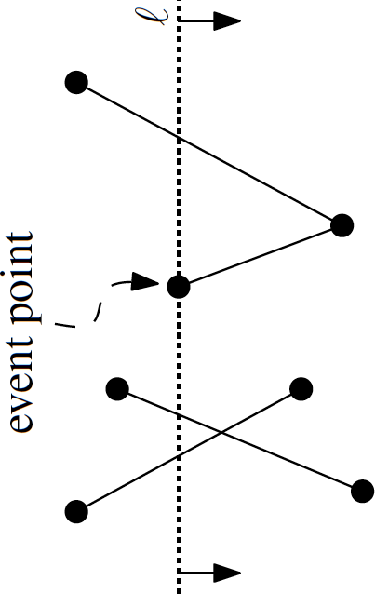
Event Queue
Need to keep events sorted:
  Lexicographic order (first by x- coordinate, and if two events have same x-coordinate then by y-coordinate)
Need to be able to remove next point, and insert new points in O(log n) time
  Use a balanced binary search tree (e.g., a
WAVL tree)
(The de Berg book sweeps top to bottom, but here sweep is left-to- right. So sweeps are “sideways”.)

Slide 113
Event Queue
The events in the event queue (sorted by x- coordinates):
  Every line-segment endpoint (left and right)
  The intersection point of every pair of line segments that are consecutive in the ordering along the sweep line.

Slide 114
Event Handling
Left segment endpoint
  Add new segment to sweep line status
  Test adjacent segments on sweep line l for intersection with new
segment
  Add new intersection points to event queue
b
c
a
e
d
c c b b d e
d

Slide 115
Event Handling
Intersection point
  Report new intersection point
  Two segments change order along l
→ Test new adjacent segments for new intersection points (to insert into event queue)
b
c
a
e
d
c c
b e
e b
d d
Note: “new” intersection might have been already detected earlier.
15

Slide 116
Event Handling
Right segment endpoint
  Delete segment from sweep line status
  Two segments become adjacent. Check for intersection points (to insert in event queue)
b
c
a
e
d
e e c c bd d
116

Slide 117
Sweep Line Algorithm
Sweep Line Algorithm: We can solve this problem in O(nLogn) time using Sweep Line Algorithm.
The algorithm first sorts the end points along the x axis from left to right, then it passes a vertical line through all points from left to right and checks for intersections.
Following are detailed steps.
Let there be n given lines.
There must be 2n end points to represent the n lines.
Sort all points according to x coordinates.
While sorting maintain a flag to indicate whether this point is left point of its line or right point.

Slide 118

2) Start from the leftmost point.
Do following for every point
…..a) If the current point is a left point of its line segment, check for intersection of its line segment with the segments just above and below it.
And add its line to active line segments
(line segments for which left end point is seen, but right end point is not seen yet).
Note that we consider only those neighbors which are still active.
….b) If the current point is a right point, remove its line segment from active list
and check whether its two active neighbors (points just above and below) intersect with each other.
The step 2 is like passing a vertical line from all points starting from the leftmost point to the rightmost point. That is why this algorithm is called Sweep Line Algorithm.

Slide 119
Sweep a plane vertically from top to bottom maintaining the set of known future events.
Events
  Beginning of a segment
  End of a segment
  Intersection to two “adjacent” segments
sweep direction

Slide 120
We maintain ordered list of segments
c
b
d
e
a
f
y
segment ordering at y = c, d, f, b, e, a

Slide 121
Just before an intersection event the two line segments must be adjacent in the segment order.
When a new adjacency occurs between two lines we must check for a possible new intersection event.

Slide 122
Event Queue
– contains all the beginning points and all the end points of segments ordered by decreasing y value.
b
c
a
Event Queue b_{a},b_{b},b_{c},b_{d},e_{d},b_{e},e_{b},e_{e},e_{a},e_{c}
d
e
Segment List
– Empty

Slide 123
Remove the next event from the event queue
begin segment event
Insert b into the segment list between a and c
Check for intersections with adjacent segments (a,b) and (b,c), and add any to event queue
c
a
b
end segment event
c
Delete b from the segment list
Check for intersections with adjacent segments (a,c), and add any to event queue
a
b

Slide 124
intersection event event
c
Reverse the order of b and c on the segment list
Check for intersections with adjacent segments (a,c) and (b,d) and add any to event queue
b
d
a

Slide 125

Several events can coincide.
begin segment event end segment event intersection event
do in left to right order
Horizontal lines
begin
end

Slide 126
b
c
a
d
e
Segment List
Event Queue
b_{a}, b_{b}, b_{c}, b_{d}, e_{d}, b_{e}, e_{b}, e_{e}, e_{a}, e_{c}

Slide 127
b
c
a
d
e
Segment List a
Event Queue
b_{b}, b_{c}, b_{d}, e_{d}, b_{e}, e_{b}, e_{e}, e_{a}, e_{c}

Slide 128
b
c
a
d
e
Segment List b, a
Event Queue
b_{c}, b_{d}, e_{d}, b_{e}, e_{b}, e_{e}, e_{a}, e_{c}

Slide 129
b
c
a
d
e
Segment List c, b, a
Event Queue
b_{d}, i_{(c,b)}, e_{d}, b_{e}, e_{b}, e_{e}, e_{a}, e_{c}

Slide 130
b
c
a
d
e
Segment List c, d, b, a
Event Queue
^{i}(d,b)^{, i}(c,b)^{, e}d^{, b}e^{, e}b^{, e}e^{, e}a^{, e}c

Slide 131
b
c
a
d
e
Segment List c, b, d, a
Event Queue
i_{(c,b)}, e_{d}, b_{e}, e_{b}, e_{e}, e_{a}, e_{c}

Slide 132
b
c
a
d
e
Segment List b, c, d, a
Event Queue
e_{d}, b_{e}, e_{b}, e_{e}, e_{a}, e_{c}

Slide 133
b
c
a
d
e
Segment List b, c, a
Event Queue b_{e}, e_{b}, e_{e}, e_{a}, e_{c}

Slide 134
b
c
a
d
e
Segment List b, e, c, a
Event Queue i_{(e,c)}, e_{b}, e_{e}, e_{a}, e_{c}

Slide 135
b
c
a
d
e
Segment List b, c, e, a
Event Queue
^{e}b^{, i}(e,a) ^{e}e^{, e}a^{, e}c

Slide 136
b
c
a
d
e
Segment List c, e, a
Event Queue ^{i}(e,a)^{, e}e^{, e}a^{, e}c

Slide 137
b
c
a
d
e
Segment List c, a, e
Event Queue e_{e}, e_{a}, e_{c}

Slide 138
b
c
a
d
e
Segment List c, a
Event Queue e_{a}, e_{c}

Slide 139
b
c
a
d
e
Segment List c
Event Queue e_{c}

Slide 140
b
c
a
d
e
Segment List
Event Queue

Slide 141

Event List
  Priority queue ordered by decreasing y, then by increasing x
  Delete minimum, Insertion
Segment List
  Balanced binary tree search tree
  Insertion, Deletion
  Reversal can be done by deletions and insertions
Time per event is O(log n)

Slide 142
Total time for plane sweep algorithm is
O(n log n + s log n) where s is the number of intersections.
  n log n for the initial sorting
  log n per event
Plane sweep algorithms were pioneered by Shamos and Hoey (1975).
Intersection Reporting - Bentley and Ottmann (1979)

Slide 143
Thank You

